Slide 1
WELCOME TO SQUIRRELS

Slide 2
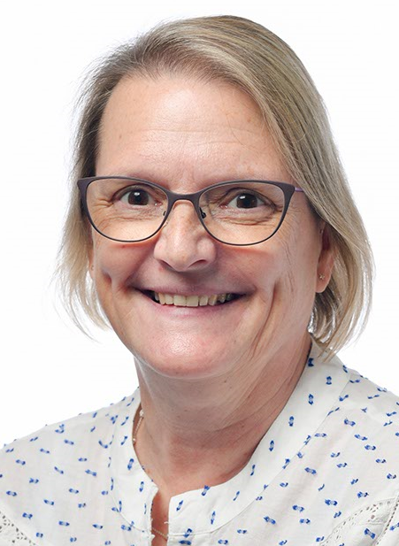
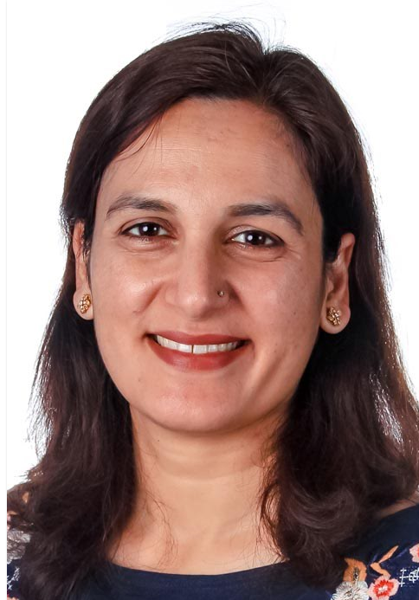
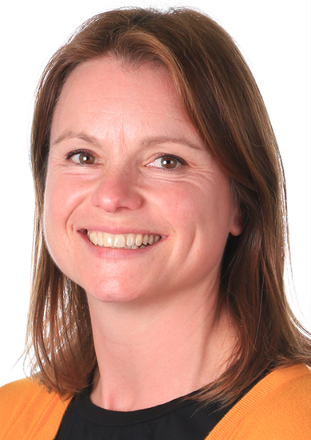

The Squirrel Team
Mrs Cox
Full time class teacher
Mrs Hassan
LSA,
Mornings
Miss Mitchell, LSA
Two afternoons
Mrs Rice
PPA class teacher cover
Thursday am

Slide 3
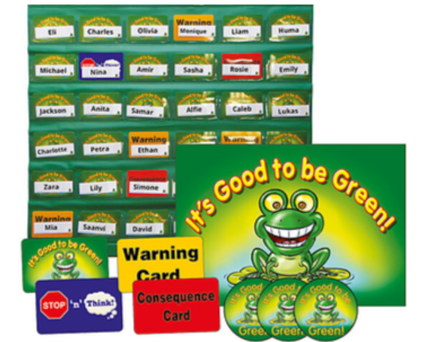
Behaviour
Good to be Green!
Green is the aim!
Blue – stop and think!
Yellow – warning.
Red – Consequence / parents informed / SLT informed and behaviour recorded.
Chances on Green, Blue, Yellow to turn round – cards can get back to green.
Red – no further chances.

Slide 4
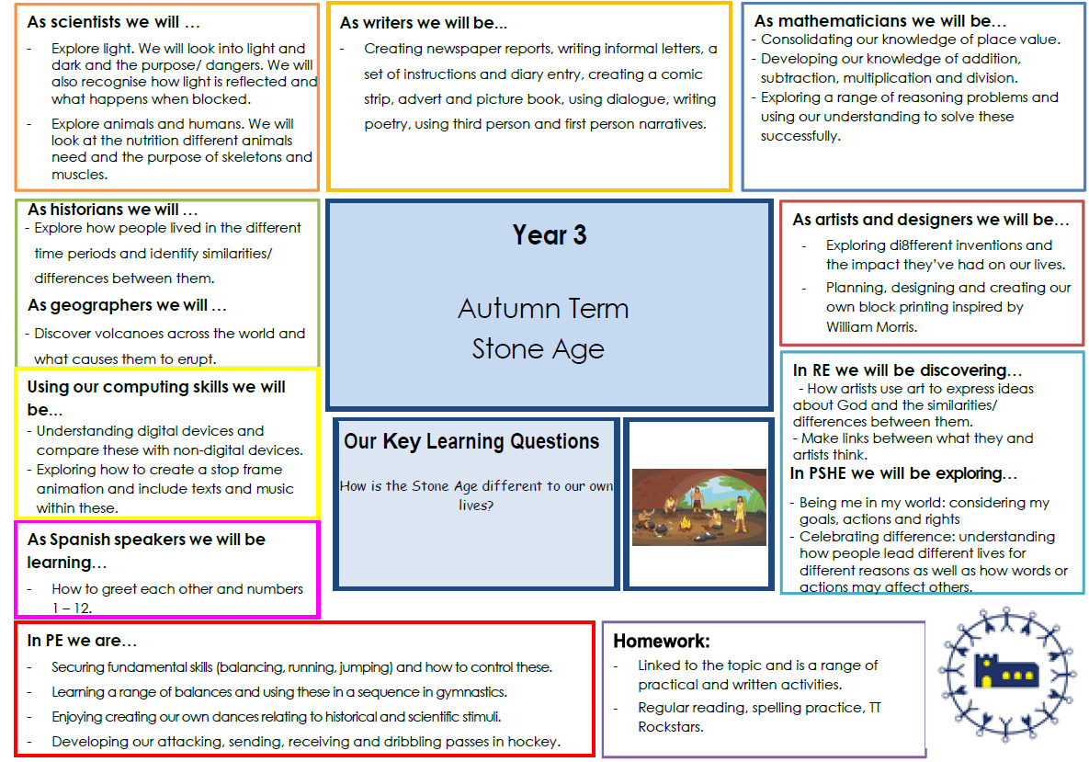
Overview

Slide 5
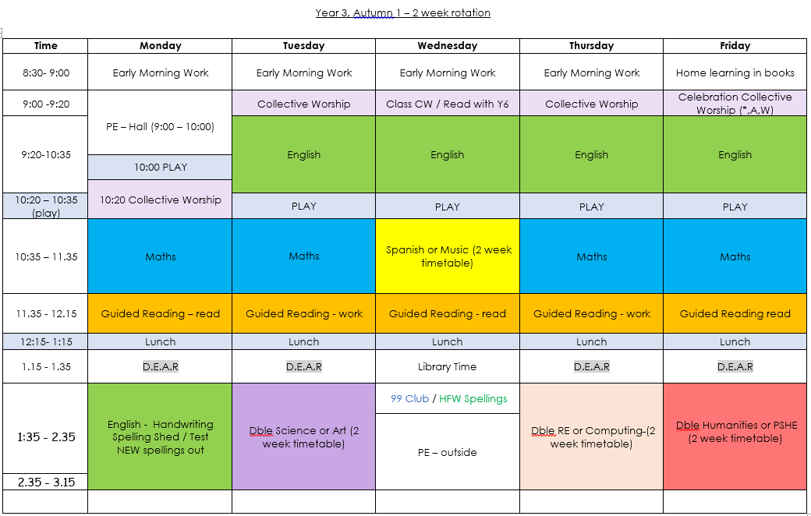
Weekly Overview
Each week is subject to change!

Slide 6
Important Days
Reading books – daily. Planners – daily.
Monday and Wednesday
PE - children to come into school in their NAMED PE kits.
Wednesday
Home learning to be returned to school.
Friday
Home learning sent home (alt weeks Maths/English work, every week Spelling Shed and TT Rockstars/Mathletics online).

Slide 7
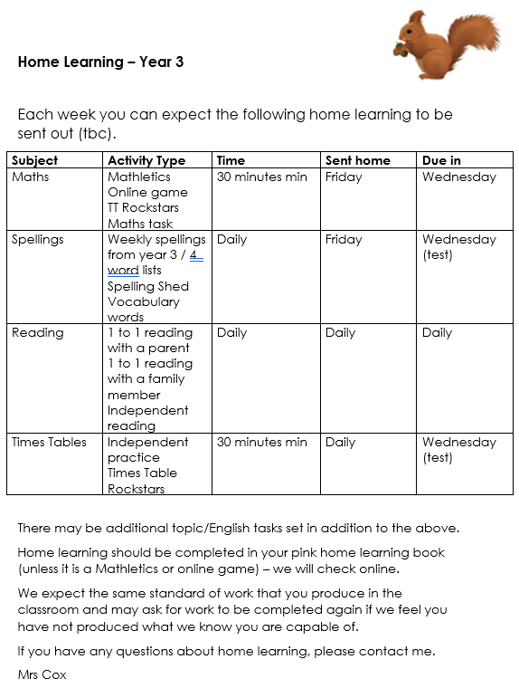
Home Learning
Maths
Mathletics or worksheet
Spellings
Spelling shed and practice spellings in planners.
Reading
Daily – Reading school book minimum 3 times, preferably 4 times (depending on book length) with adult signing planner.
purple home learning book.

Slide 8
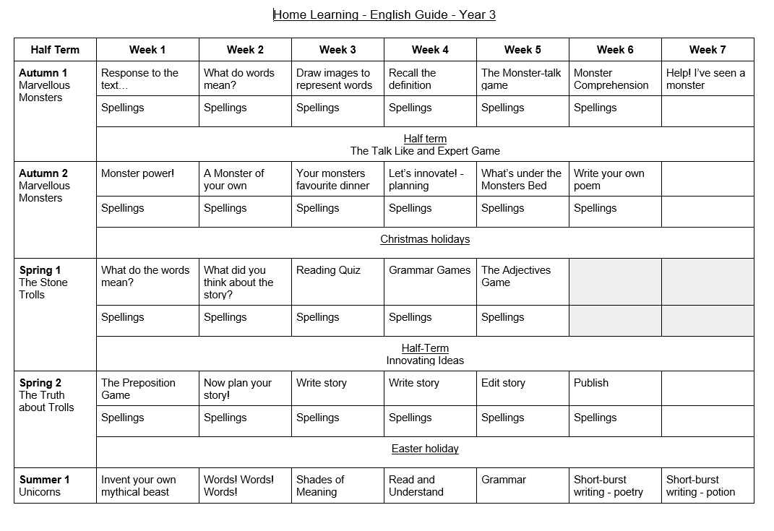
Home Learning
Year 3…
English
Tasks: Some will be activity based and some grammar based around a story.
You will get your first story and activity stuck in the HL book (purple). When you get this we expect it should take 30 minutes to complete.
Please let us know with a comment if this takes much longer as it is a new idea and we will need to monitor for any changes that may need to be made.

Slide 9
Reading
Children will continue to be assessed and given books according to their reading outcomes/ability.
Comprehension focus – word reading may be fluent but comprehension may need further work.
Children not on colour banded books will continue to receive LW keep up work and a book aligned to their LW assessment.
Books are changed up to twice a week.
Spelling shed supports reading skills.

Slide 10
Forest School
We will be attending Forest School for 3 sessions in Spring 1 and later in the year, in Summer 1/2.
This will allow the children the opportunity to experience Forest School in different seasons.
This will be as last year with half the class attending one week and the other half on the following week.
Our class assembly will be held at the Forest School, giving you a chance to see what they do!

Slide 11
How You Can Help
Do, read with your child regularly and sign you have heard them read, please! Daily reading is still expected in KS2.
Continue to support them with their home learning tasks!
Use Mathletics, Spelling Shed and TimesTable Rockstars when set as home learning.
Encourage independence, e.g. can they prepare themselves for the day? Do they have their planners, water bottles etc?

Slide 12
Events this year…
Stone Age Workshop (27th November 2025).
Making Volcanoes (Autumn).
Swimming in Spring/Summer term. (tbc)
Visit to Butser Ancient Farm - Romans (20th March 2026).
Sleepover in the Summer term! (tbc)

Slide 13
Communication
Our Communications Policy shows the best way to contact us.
info@lyne.surrey.sch.uk
We mainly use:
ParentMail
Marvellous Me
Our class page on the school website
I will always be on the door at the end of the day if you ever need to ask a quick question.

Slide 14
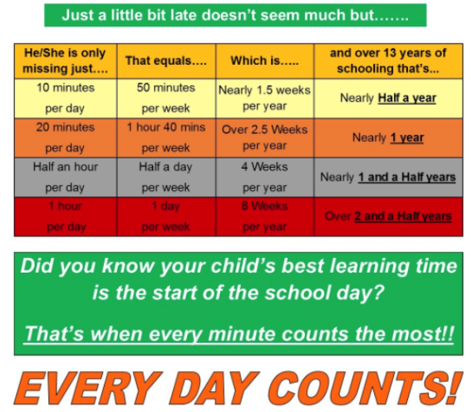
What sort of start is your child getting?
Being at school on time matters!
The DfE have high expectations for attendance and are pushing schools to follow up closely on absence with more sanctions for non attendance.
If Calpol etc will see them through, then we want to see children in school!

Slide 15
Finally…
Keep in touch! We want this to be a happy, fun and successful year for all of the children - please let us know if you have any questions or concerns over the year.

