Slide 1

Promoting a love of books and reading with younger children
Notes:
Thank you for taking time to join is
This is the first of our parent meetings, the next will be Maths linked
The aim of the meetings is to show you how we promote a love of reading in school, provide some ideas for home and inform you of some up and coming events that we have
This session will be split into two parts the first about promoting reading for enjoyment and the second to inform new reception parents about our phonics scheme and reading system
I have put together both sessions but Miss Neilson and Miss Mayger will be running the KS2 meeting, some ideas will be similar but there are differences
So let’s get stuck in…

Slide 2


Why is reading to children important?
Supporting cognitive development – remembering, problem solving and decision making
Improved language skills - introduces children to a wealth of vocabulary that they would not be able to access themselves
Developing a bond
Increased concentration – they are able to focus for the duration of short stories which can be increased as appropriate
Improved imagination and creativity
Cultivating a life long love of reading

Slide 3

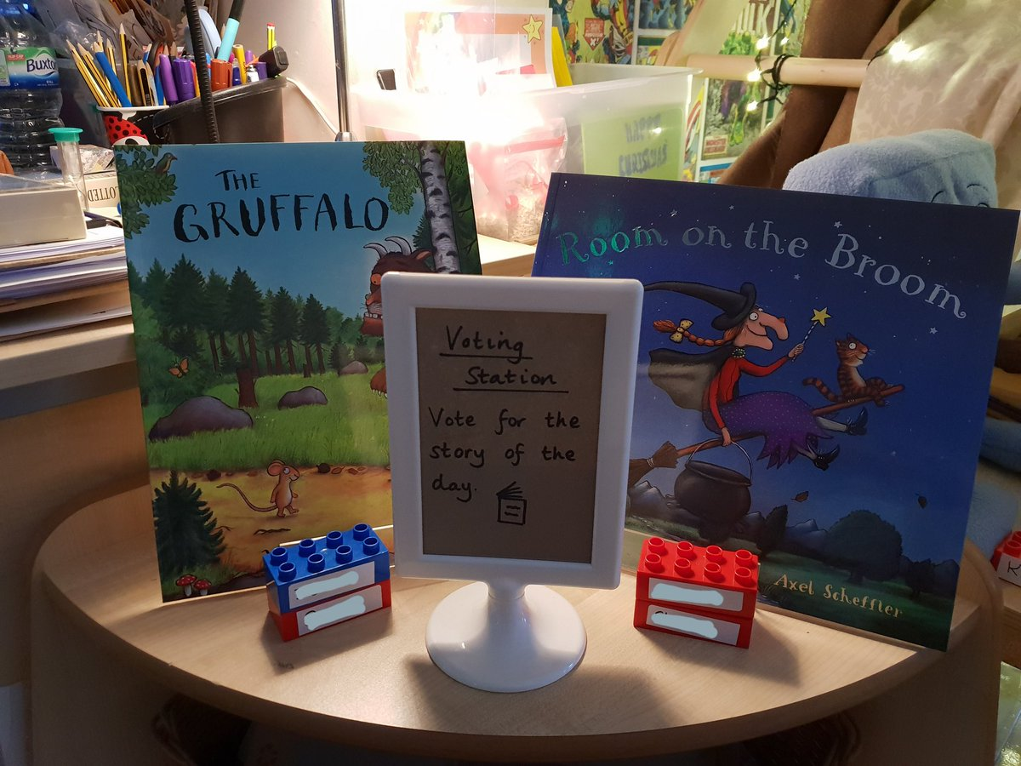

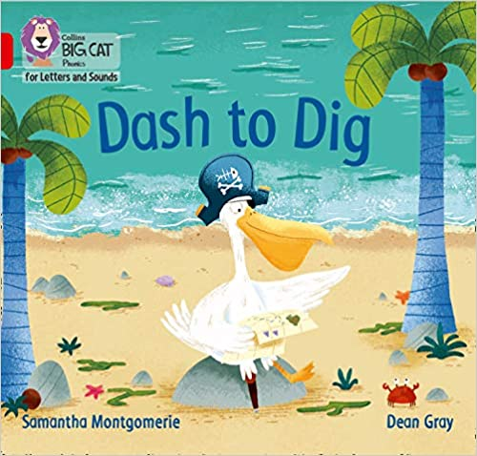
How do we promote an enjoyment of reading in school?
Using a range of texts to inspire Literacy Lessons
Investment in new and more engaging books for reading sessions
Daily stories read to the children- trialling voting
World Book Day/Week
Well resourced reading areas
Inspirational author visits
The book bus
Book to share boxes
Notes:
Reading and promoting an enjoyment of books underpins our Literacy teaching and themes that we teach

Slide 4

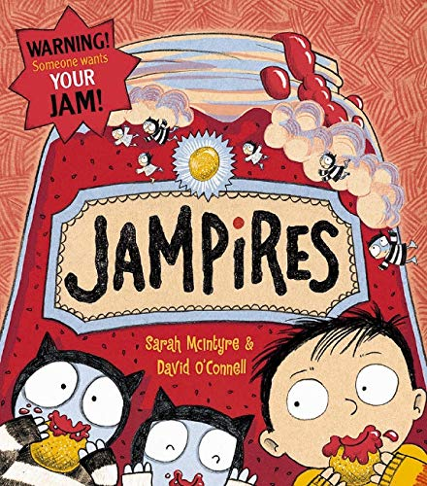

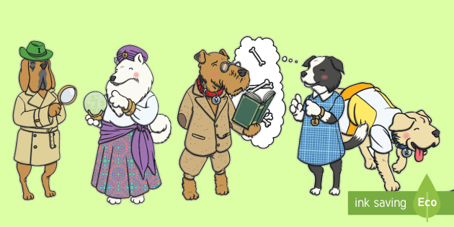
Class Copies of a range of texts in Year 2 for their transition to whole class guided reading
Notes:
In year 2, when children have completed the phonics programmes, we transition to daily whole class guided reading rather then group reading. We introduce the teaching of skills using reading dog characters to give meaning to skills in a child friendly way. We introduced it last year so have invested more in 15 copies of a range of texts to continue it through the year.

Slide 5
Ideas for Promoting a love of reading at home
Sharing picture books with your children
Show them that you like to read too!
Make sure that reading is part of your daily routine
Use the books as ideas for fun activities
-The tiger who came to tea
-The three little pigs
Don’t forget to share a range of texts
Change up where you read
Audiobooks for the car
Notes:
-Be expressive and enjoy reading the book yourself
Where you read – bundle up outside on a chilly day with hot chocolates, use a torch, take books to relatives houses for them to read

Slide 6
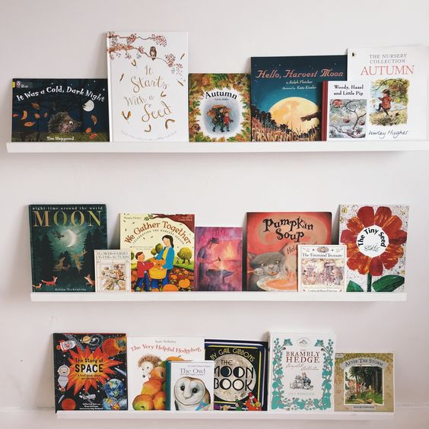
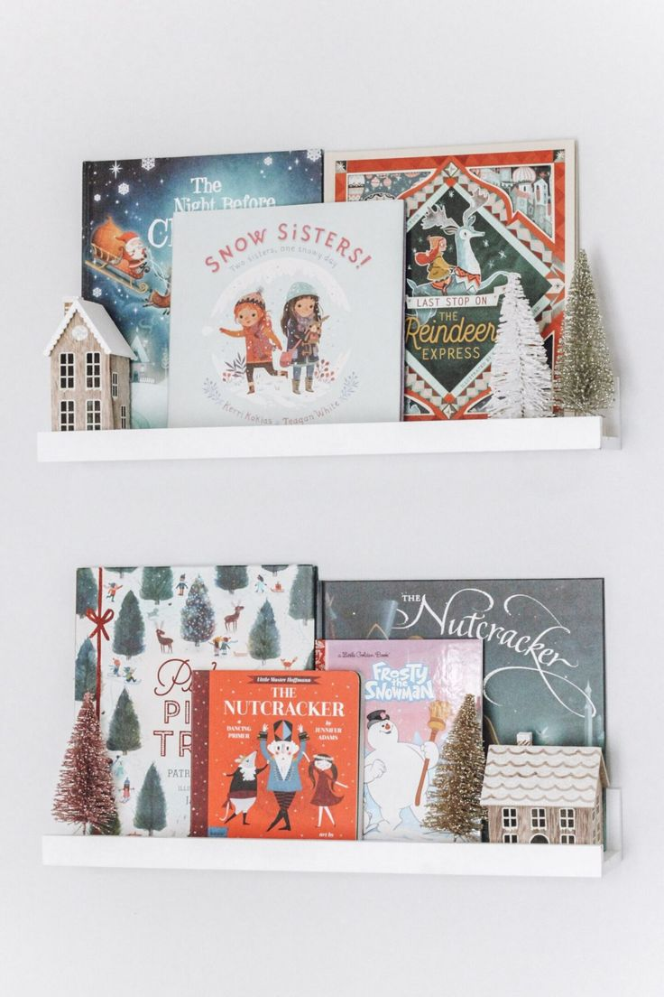
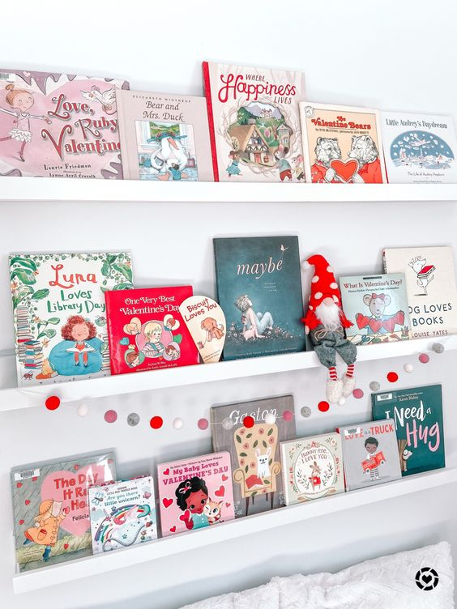
Ideas for Promoting a love of reading at home
Trips to the library to create a themed bookshelf
Spring | Summer | Autumn | Winter
Valentines Day (love, friendship), St Patricks Day, Earth Day, St George’s Day | Sports | Back to School, celebrating differences | Arctic Animals
Easter | Holidays, countries, transport | Harvest, Fire safety, bonfire night, Diwali , Remembrance | Snow and Ice stories
Life Cycles | Beach and sea animals | Hibernation | Christmas, New year, new beginnings, Chinese New Year
Notes:
Such a lovely idea to create themes, use toys, pictures and little objects to explore and bring texts to life

Slide 7
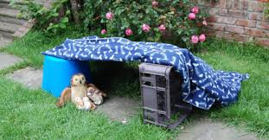
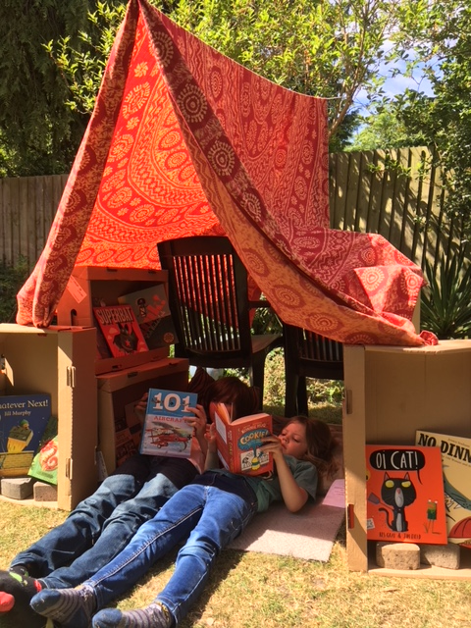
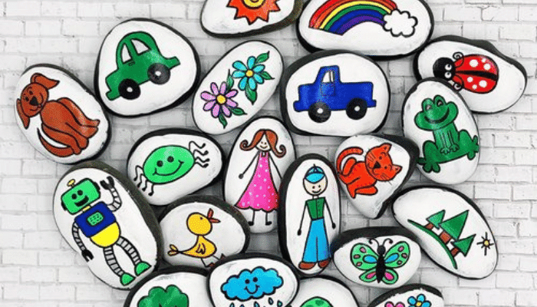
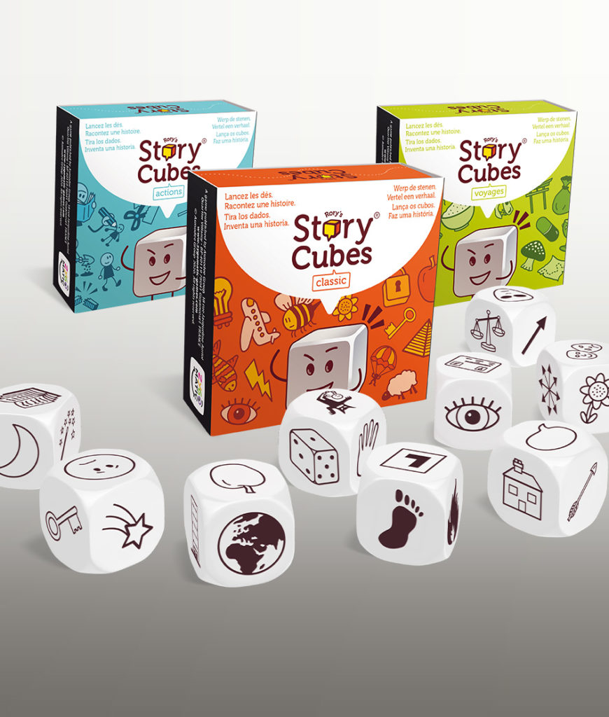

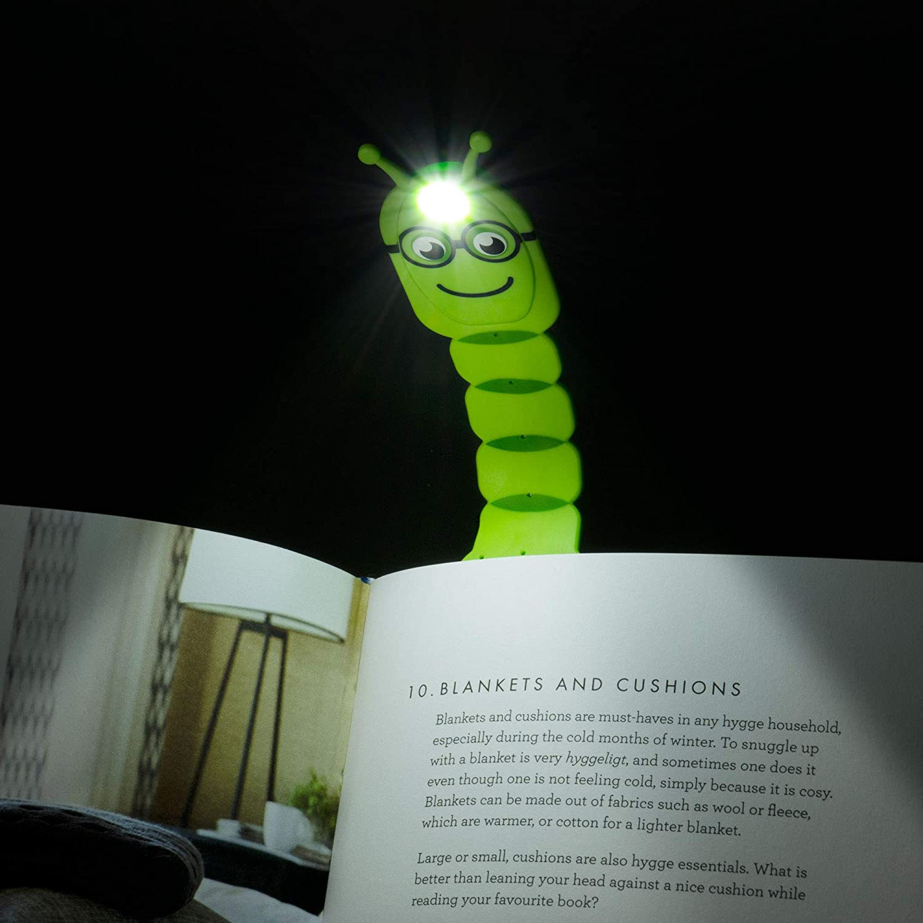
Create Reading dens and nooks
Notes:
Making reading exciting and a nice family activitym make lollipop puppets, use story stones and teddies.

Slide 8


Follow your local library on social media to keep updated with upcoming events

Slide 9
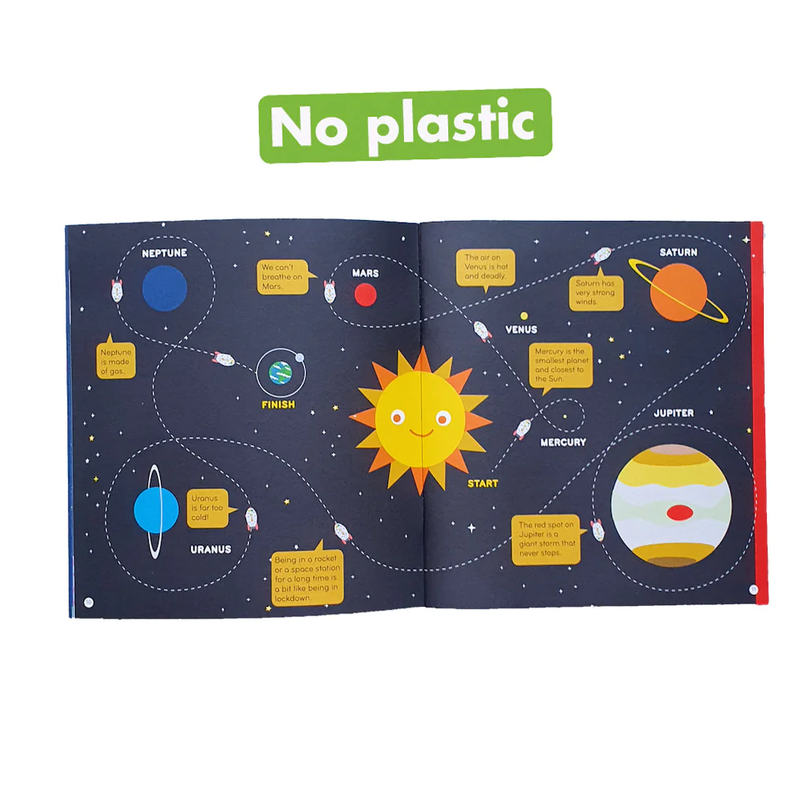
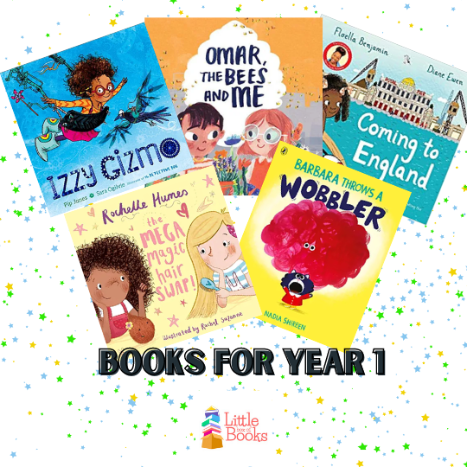

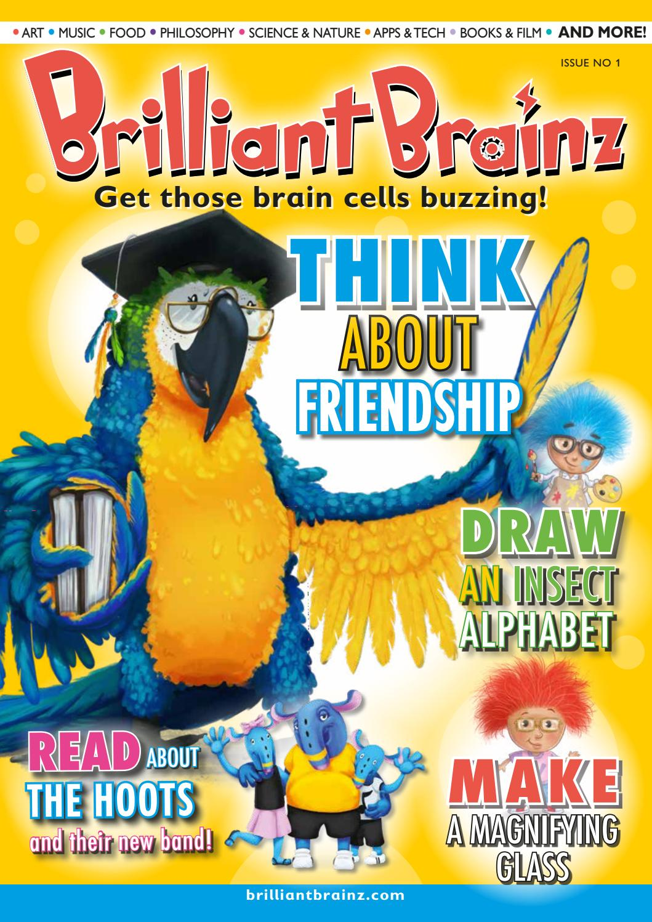
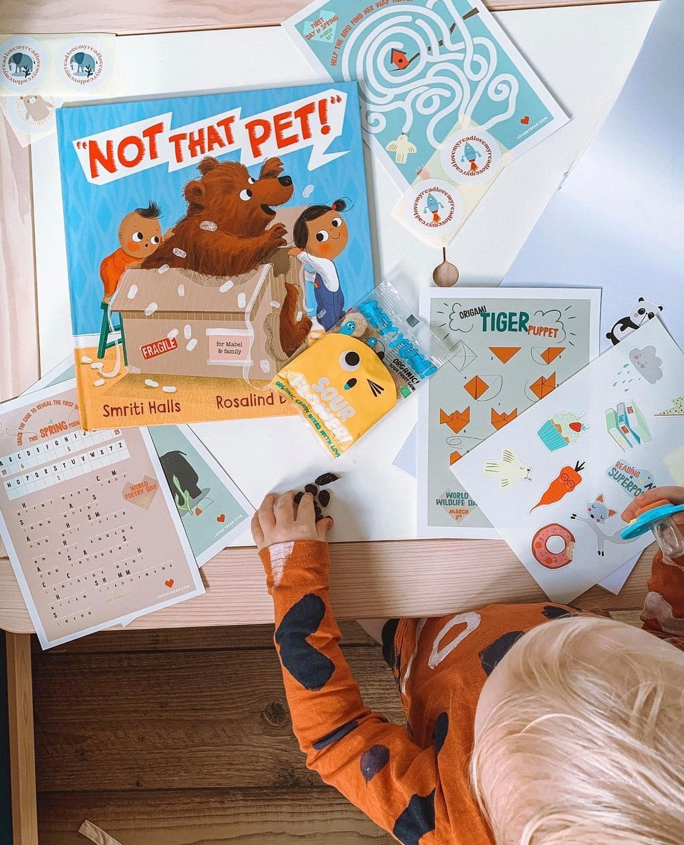

Subscriptions and gift ideas
https://store.okido.com/pages/shop
The Little Box of Books
Use for ideas or gift boxes
Okido Science based magazine for 3 to 7 year olds
https://littleboxofbooks.co.uk/
Brilliant Brainz Magazine for 6 to 12 year olds
https://lovemyread.com
https://www.brilliantbrainz.com/
Notes:
89 days till christmas
Little box of books – you can get a subscription but also just look for a range of new ideas for what is popular
Okido - Each magazine is carefully created by scientists and educators, promoting fun and immersive STEAM learning with a new topic to explore every month. So much more than just a magazine, your children can get stuck in with experiments, recipes, doodles, games and other exciting activities!
Brilliant Brainz - Brilliant Brainz is arts, music, wellbeing, science and culture all in one magazine for 6-12 year olds!
Helping children to question what’s around them, inspire their creativity and encourage them to read for pleasure!
Love my read – one off or gift subscription box

Slide 10
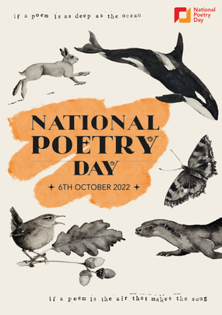
Upcoming Events
National Poetry Day Competition
Thursday 6th October Theme – The environment Teachers will be sharing their favourite poems in collective worship daily. Children will be challenged to write a poem about the environment for their home learning this week. 5 poems will be chosen to read their poems in a celebration assembly (their parents/family will be invited) . Children will receive a small prize and the 5 poems will be put onto the website and shared in a newsletter.
https://childrens.poetryarchive.org/explore/
https://www.youtube.com/c/MichaelRosenOfficial
Notes:
Such an important theme!
Like a mini recital!

Slide 11
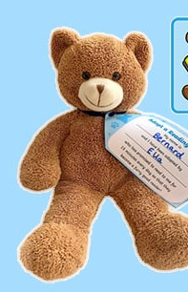
Upcoming Events
October Half Term Reading Challenge Adopt a Reading Bear
We need your help! -Children to donate a washed teddy bear (or two) to the school (date to be communicated) -We will then line them up in the library and each KS1 class with the help of our library leaders will child will adopt a brand new bear and tag it on the last week of the term -Their challenge is to read and share books with the bear over half term We’d love to see photos

