Slide 1

Promoting a Love of Reading for children in Key
Stage 2

Slide 2


Why is reading for enjoyment important?
Encourages imagination and critical thinking
Expands vocabulary and improves writing skills
Improves well-being and empathy
Helps them gain an insight into the world and views of others

Slide 3
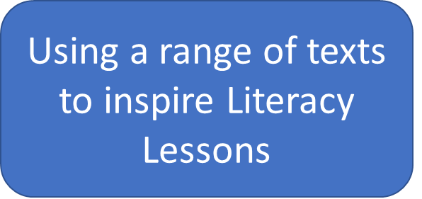
How do we promote an enjoyment of reading in school?
Whole School Reading themed weeks
Drop Everything and Read timetabled during the school day
Having copies of class texts for guided reading for children to share
World Book Day/Week
Inspirational author visits
Selecting a range of texts that explore different genres and themes for whole class guided reading sessions

Slide 4
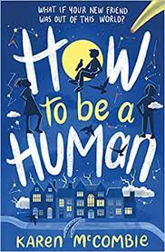

Whole Class Reading Text Choices
Year 3 Spotlight Texts
The Secrets of Stonehenge (Autumn) Element of non-fiction Links to class learning Great for keen historians Curiosity and wonder Why was this amazing monument erected? How did our Stone-Age ancestors bring such massive stones to the site from so far away? How did they raise the enormous stones to their upright positions? What was Stonehenge used for, and who lived around the site? With captions and pictures, and using up-to-the-minute research discoveries, Mick Manning and Brita Granstrom tell the incredible true story of this awe-inspiring monument - one of the greatest ancient sites in the world. | How to be a Human (Summer) -Fiction -Inspire imagination – what about the people They see out and about? Who might they be? -Theme of self-discovery Who said friends have to match to matter? When the Star Boy's space-pod crashes in the grounds of Fairfield Academy he knows he must seek shelter. Taking refuge in the school's boiler room to await rescue he discovers that the room's small window is the perfect place to watch humans go by.

Slide 5
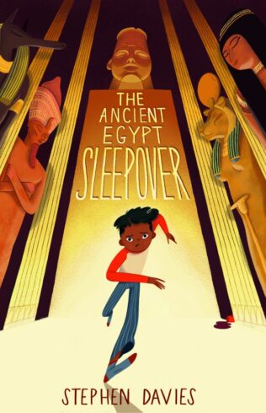
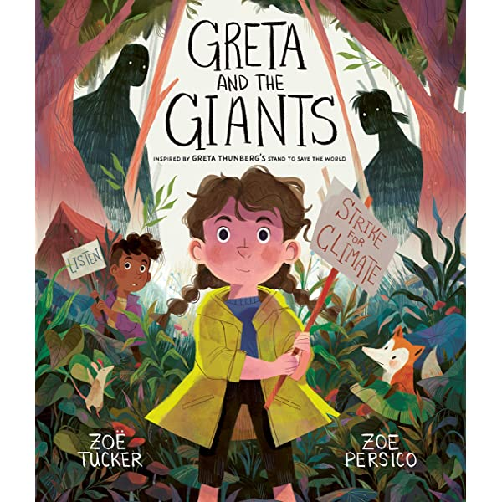
Whole Class Reading Text Choices
Year 4 Spotlight Texts
The Ancient Egypt Sleepover (Autumn) -Links to learning -Fictional and educational -Themes of bravery and determination Mo has won a very special prize, an Ancient Egypt Sleepover in the British Museum. But he has no clue how dangerous it will be. With a mystery to solve, codes to crack and priceless treasure to save, one thing is for sure: Mo will not be getting any sleep tonight! | Greta and the Giants (Summer) -Covers real world issues in an accessible way (climate Change) -Links to a young activist fighting for change Greta is a little girl who lives in a beautiful forest threatened by Giants. When the Giants first came to the forest, they chopped down trees to make houses. Then they chopped down more trees and made even bigger homes. The houses grew into towns and the towns grew into cities, until now there is hardly any forest left. Greta knows she has to help the animals who live in the forest, but how? Luckily, Greta has an idea... A section at the back explains that, in reality, the fight against the "giants" isn't over and explains how you can help Greta in her fight.

Slide 6


Whole Class Reading Text Choices
Year 5 Spotlight Texts
Cloud busting (Spring) -Exploring different types of Poetry in each chapter -Written in verse -Theme of friendship Davey is the new boy in class and Sam can't stand him. He thinks Davey is a Grade A moron. But when the two are thrown together Sam discovers that Davey's eccentric way of looking at the world makes life a lot more fun. Until the day something terrible happens... | Wonder (Summer) -Fiction -Themes of belonging, courage, growing up and bullying -Lots of vocabulary to unpick 'My name is August. I won't describe what I look like. Whatever you're thinking, it's probably worse.' Auggie wants to be an ordinary ten-year-old. He does ordinary things - eating ice cream, playing on his Xbox. He feels ordinary - inside. But ordinary kids don't make other ordinary kids run away screaming in playgrounds. Ordinary kids aren't stared at wherever they go. Born with a terrible facial abnormality, Auggie has been home-schooled by his parents his whole life. Now, for the first time, he's being sent to a real school - and he's dreading it. All he wants is to be accepted - but can he convince his new classmates that he's just like them, underneath it all?

Slide 7
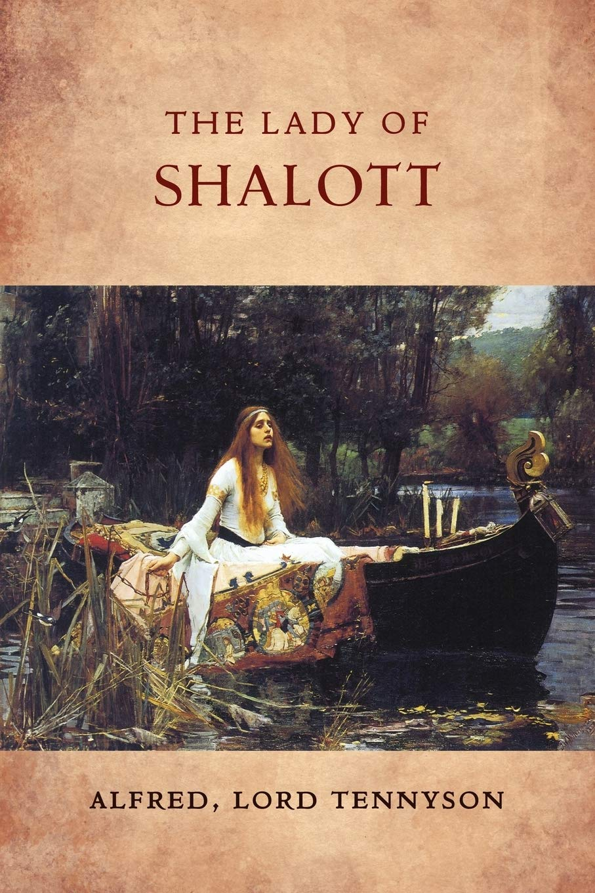

Whole Class Reading Text Choices
Year 6 Spotlight Texts
The Lady of Shallott (Autumn) -Poetry -Exploring themes isolation and detachment -Classic text Alfred Lord Tennyson's four-part poem 'The Lady of Shalott' tells the story of a young medieval woman mysteriously imprisoned on an island near Camelot. She must weave a colorful web and only watch the outside world through a mirror. If she looks at Camelot directly, she will be cursed. | Pig Heart Boy (Spring) -Themes of friendship, loyalty and forgiveness -Thought-provoking read -Allows for questions and debates Cameron needs a heart transplant, and when a pioneering doctor offers to give him a new heart, from a pig, Cameron knows he has to try - to become the world's first pig-heart boy.

Slide 8




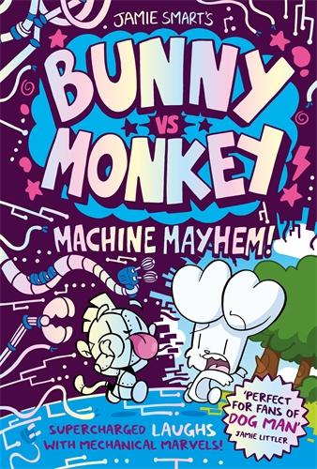




New Release Books – Coming this Autumn

Slide 9
Ideas for Promoting a love of reading at home
Create reading shelves based on your child’s interests
Show them that you like to read too!
Make sure that reading is part of your daily routine – perhaps all take 15 minutes to read at the same time
Family book club with a treat snack or drink (popcorn and hot chocolates?)– Take it in turns to read chapters or pages of your child’s book and discuss what has been read
Read the book version before you see the movie or theatre show – this will lead to great discussions
Use books and visits to libraries as a reward
Audiobooks
Notes:
-Be expressive and enjoy reading the book yourself
Where you read – bundle up outside on a chilly day with hot chocolates, use a torch, take books to relatives houses for them to read

Slide 10
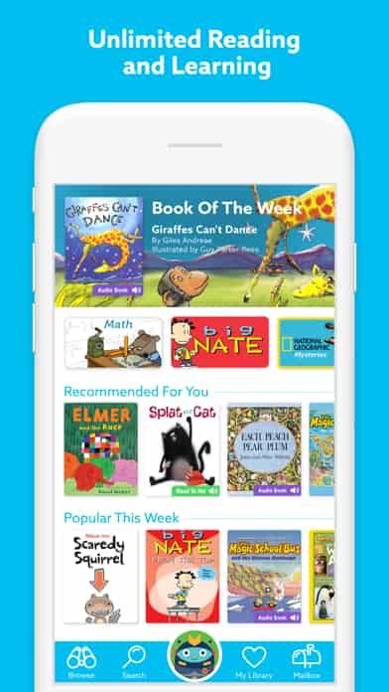
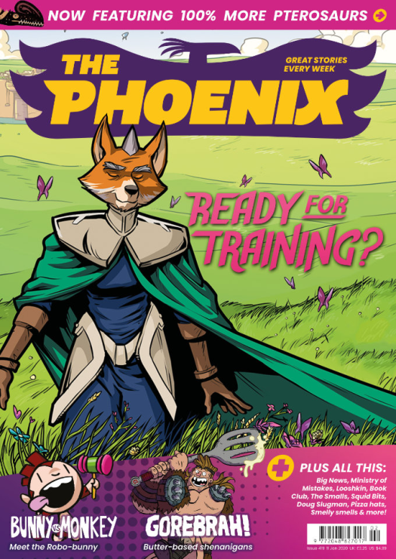


Subscriptions, rewards and gift ideas
The Phoenix
First 6 issues for £1
‘In each issue we publish a range of stories. Over time these stories are published as full graphic novels in our Phoenix Presents series. This means we can tell more in depth and high quality stories than you might expect to find in a children’s comic.’
Access to free eBooks and audiobooks for a range of ages
Epic! Reading app, it’s like a Bookflix. (small cost)
Notes:
89 days till christmas
Little box of books – you can get a subscription but also just look for a range of new ideas for what is popular
Okido - Each magazine is carefully created by scientists and educators, promoting fun and immersive STEAM learning with a new topic to explore every month. So much more than just a magazine, your children can get stuck in with experiments, recipes, doodles, games and other exciting activities!
Brilliant Brainz - Brilliant Brainz is arts, music, wellbeing, science and culture all in one magazine for 6-12 year olds!
Helping children to question what’s around them, inspire their creativity and encourage them to read for pleasure!
Love my read – one off or gift subscription box

Slide 11
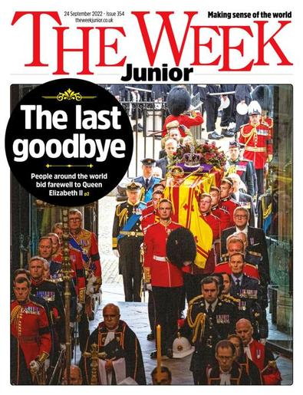

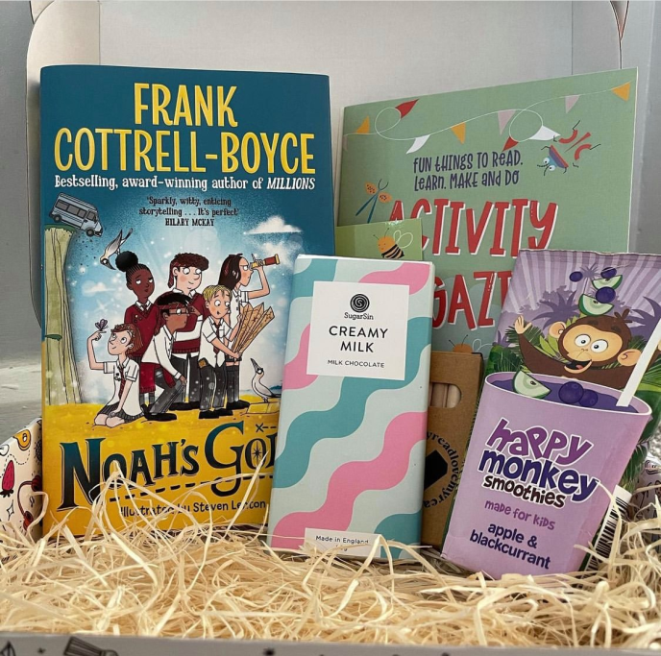
Subscriptions, rewards and gift ideas
https://littleboxofbooks.co.uk/
Little Box of Books
You can buy boxes of books or browse different themes and age ranges and inspiration to then go and borrow or buy separately.
The Week Junior
Its fun-to-read pages are packed with stories they’ll love – news, nature, science and brain-boosting puzzles. (First 6 issues free)
https://theweekjunior.co.uk
Love my read
They send books and treats through the post
OR
Use the idea as inspiration for you own, or get your child to make it as a gift for friends/ siblings
https://lovemyread.com
Notes:
89 days till christmas
Little box of books – you can get a subscription but also just look for a range of new ideas for what is popular
Okido - Each magazine is carefully created by scientists and educators, promoting fun and immersive STEAM learning with a new topic to explore every month. So much more than just a magazine, your children can get stuck in with experiments, recipes, doodles, games and other exciting activities!
Brilliant Brainz - Brilliant Brainz is arts, music, wellbeing, science and culture all in one magazine for 6-12 year olds!
Helping children to question what’s around them, inspire their creativity and encourage them to read for pleasure!
Love my read – one off or gift subscription box

Slide 12
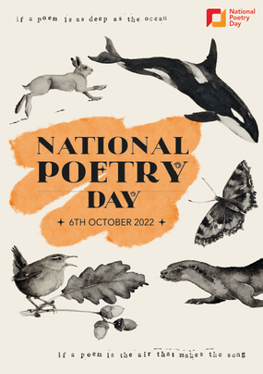
Upcoming Events
National Poetry Day Competition
Thursday 6th October Theme – The environment Teachers will be sharing their favourite poems in collective worship. Children will be challenged to write a poem about the environment for their home learning this week. 5 poems will be chosen to read their poems in a celebration assembly (their parents/family will be invited) . Children will receive a small prize and the 5 poems will be put onto the website and shared in a newsletter.
https://childrens.poetryarchive.org/explore/
https://www.youtube.com/c/MichaelRosenOfficial
Notes:
Such an important theme!
Like a mini recital!

Slide 13
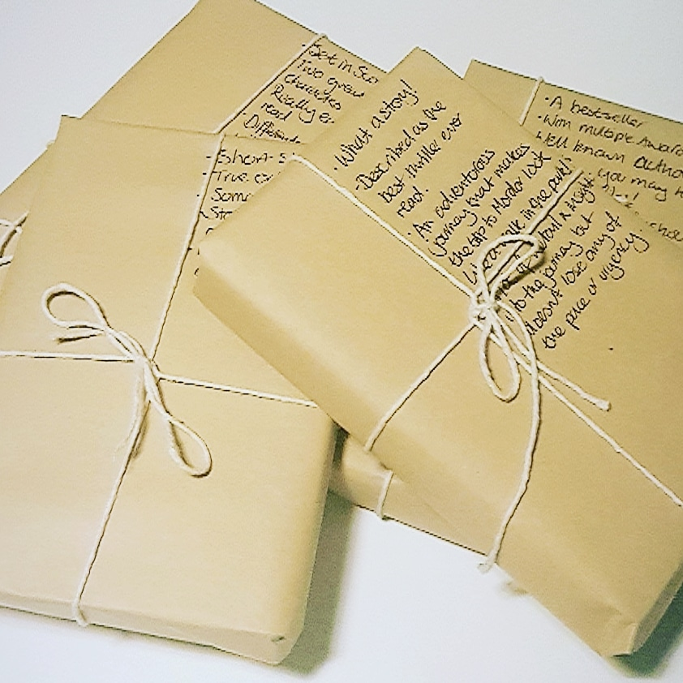
Upcoming Events
October Half Term Reading Challenge The Mystery Book Swap
We need your help! -Children to donate a book or two that they have enjoyed reading (date to be communicated) -We will then sort them in to genres and wrap them -All children in KS2 will choose a wrapped book to open, read and review over the half term -We’d love to see photos of where your child chose to read their books

Slide 14
Before you go…
Notes:
You are invited to the library to choose a book for your child to read at home.
I have made reward book marks and printed some sheets for each year group for some recommended reads
You can enjoy a coffee too!

