Slide 1


Addition and Subtraction
Todays aims:
Mental strategies that may be new to you
Partitioning to add and subtract
Column addition and subtraction
If your phone service allows – complete this 3 question survey!

Slide 2

We encourage children to be critical and evaluative of their strategies.
We aim for them to build a knowledge of methods and select which is most suitable.
Even when children build their knowledge of ‘formal written’ strategies they still need to be able to use mental methods when appropriate.

Slide 3
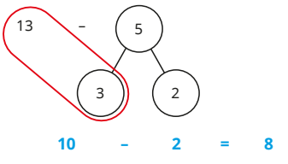
Mental strategies
KS1
Year 1
Beginning of year 2
Children need to use their fluent number bonds to spot patterns with larger numbers
What changes? What do you notice?
We encourage children spot number bonds in all they do
This applies even up in year 5 and 6!
430,000 – 50,000
Begin by taking away 30,000 then the remaining 20,000

Slide 4
Mental strategies
KS1
Year 1
Beginning of year 2
Let’s try…
37 + 13
240 - 50
KS2 context
123,564 + 8,000

Slide 5
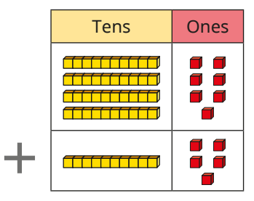
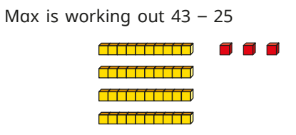
Adding and subtracting 2 digit numbers
KS1
Year 2 onwards

Slide 6
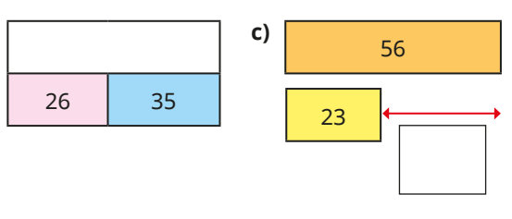
Adding 2 digit numbers
KS1
Year 2 onwards
Let’s try…

Slide 7
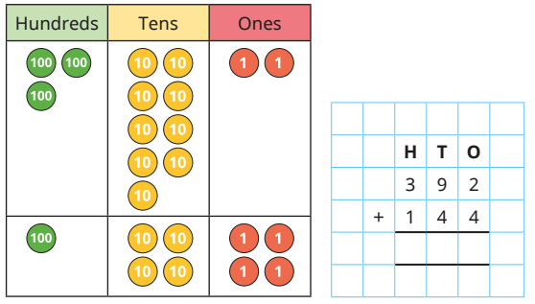


Introduction to column addition
KS2
Year 3 onwards
Column addition
Alongside pictorial representation and resources

Slide 8
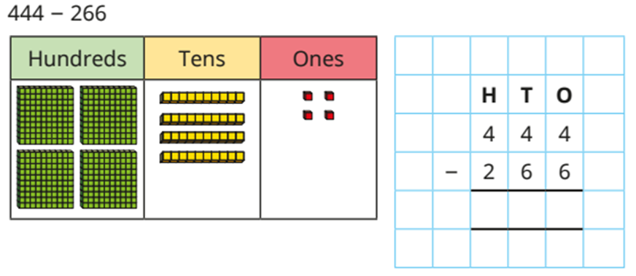
Introduction to column Subtraction
KS2
Year 3 onwards
Column addition
Alongside pictorial representation and resources

Slide 9

column addition
KS2
column Subtraction
Let’s try…
342 + 678
521 - 464

Slide 10
Let’s try…
2645 + 182
5.61 + 4.69
2827
10.3
1273 - 98
13.2 – 3.33
1175
9.87

Slide 11

Ending survey

