Slide 1

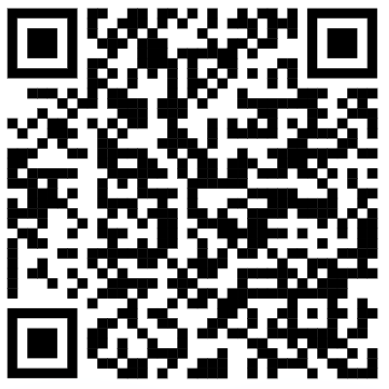
Fractions
Todays aims:
Finding fractions
Equivalent fractions
Ordering fractions
Arithmetic on fractions
If your phone service allows – complete this 3 question survey!

Slide 2

We encourage children to be critical and evaluative of their strategies.
We aim for them to build a knowledge of methods and select which is most suitable.
Even when children build their knowledge of ‘formal written’ strategies they still need to be able to use mental methods when appropriate.

Slide 3
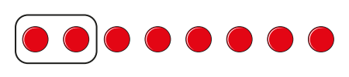
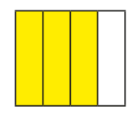
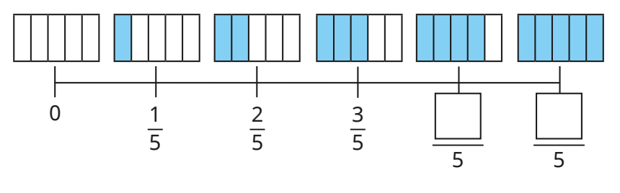
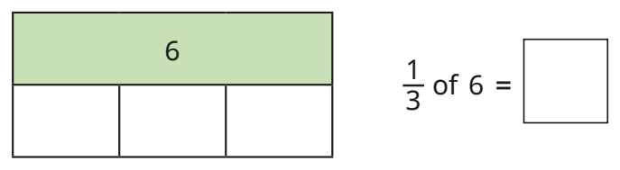
To begin…
KS1
Year 2 onwards
Visuals and early ideas
Whole Part
This is our whole.
The whole is made up of ___ equal parts.
___ equal parts make a whole.
We have ___ parts.

Slide 4
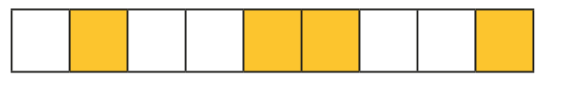
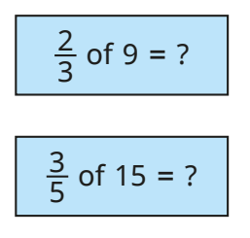
To begin…
KS2
Year 3 onwards
Let’s try
Whole Part
This is our whole.
The whole is made up of ___ equal parts.
___ equal parts make a whole.
We have ___ parts.
What fraction of our shape is shaded?
Can you find…

Slide 5
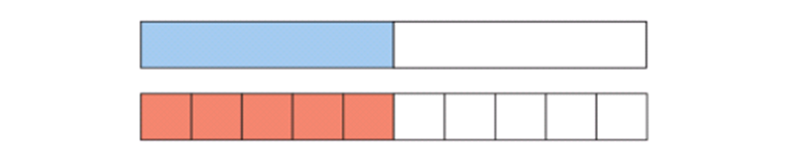

Finding equivalent fractions
Finding a common factor
3
6
Simplest form

Slide 6
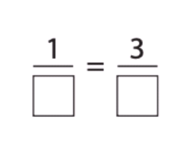
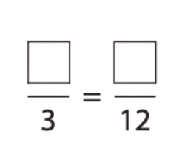
Finding equivalent fractions
Let’s try

Slide 7
Improper to mixed fraction
14
2
2
3
7

Slide 8
Ordering and comparing
Common denominator
2
5
3
6

Slide 9

Adding and subtracting
2
5
+
3
6
1
1
-
3
4

Slide 10
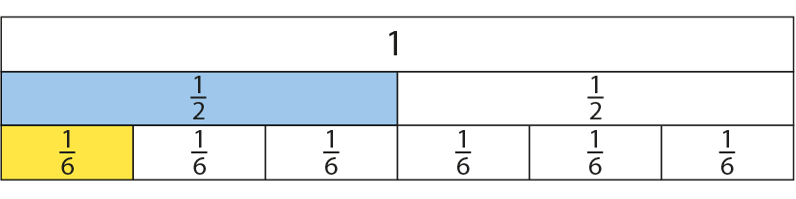
Multiplication
2
5
x
3
4

Slide 11
Division
2
÷
5
3

Slide 12
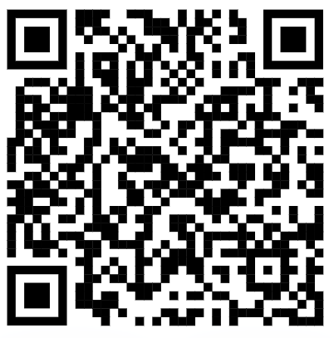
Ending survey

