Slide 1


Multiplication and division
Todays aims:
Mental strategies that may be new to you
Partitioning to add and subtract
Column addition and subtraction

Slide 2

We encourage children to be critical and evaluative of their strategies.
We aim for them to build a knowledge of methods and select which is most suitable.
Even when children build their knowledge of ‘formal written’ strategies they still need to be able to use mental methods when appropriate.

Slide 3

Mental strategies
KS1
Year 2 onwards
Multiplication
Children need to use their fluent in their times tables
6, 12, 18…
6 x 2 = 12
Children can recall facts, not count up in a lengthy process
Arrays are a helpful, early, visual
6 + 6 = 12
2 + 2 + 2 + 2 + 2 + 2 = 12 (repeated addition)
6 groups of 2
2 groups of 6

Slide 4
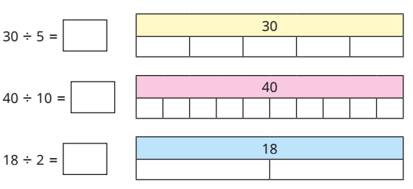

Mental strategies
KS1
Year 2 onwards
Division
Associating divisions with their related multiplication facts
5 x 6 = 30
Halving

Slide 5
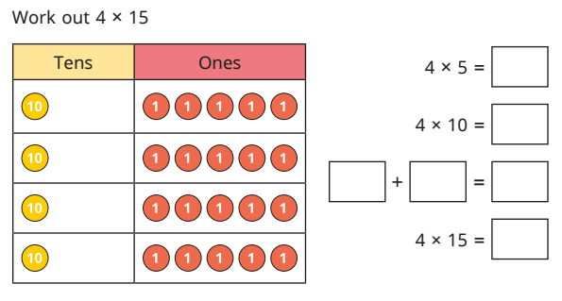
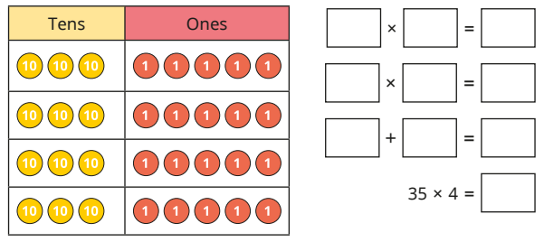
Multiplying 2 digit numbers
KS2
Year 3 onwards
Partitioning
What’s being shown here?

Slide 6
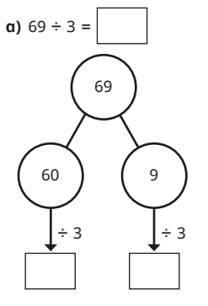
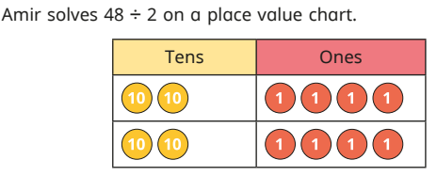
Dividing a 2 digit number
KS2
Year 3 onwards
Partitioning

Slide 7
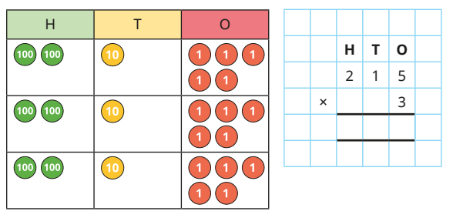

Short multiplication
KS2
Year 4 onwards
Visual, if needed

Slide 8
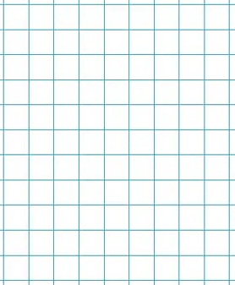
Long multiplication
KS2
Year 5 and 6
244 x 5

Slide 9
Short multiplication
KS2
Long multiplication
Let’s try…
42.3 x 23
(x10)
423 x 23
(divide answer by 10)
342 x 4
423 x 23

Slide 10
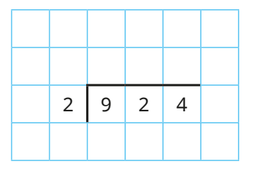
Short division
KS2
Year 4 onwards

Slide 11
Short division
KS2
Let’s try…
679 ÷ 4

Slide 12
Let’s try…
234 x 8
325 ÷ 5
1872
65
173 x 46
6321 ÷ 7
7958
903

Slide 13
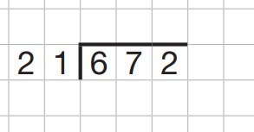
Long division
Year 6

Slide 14

Ending survey

